Slide 1
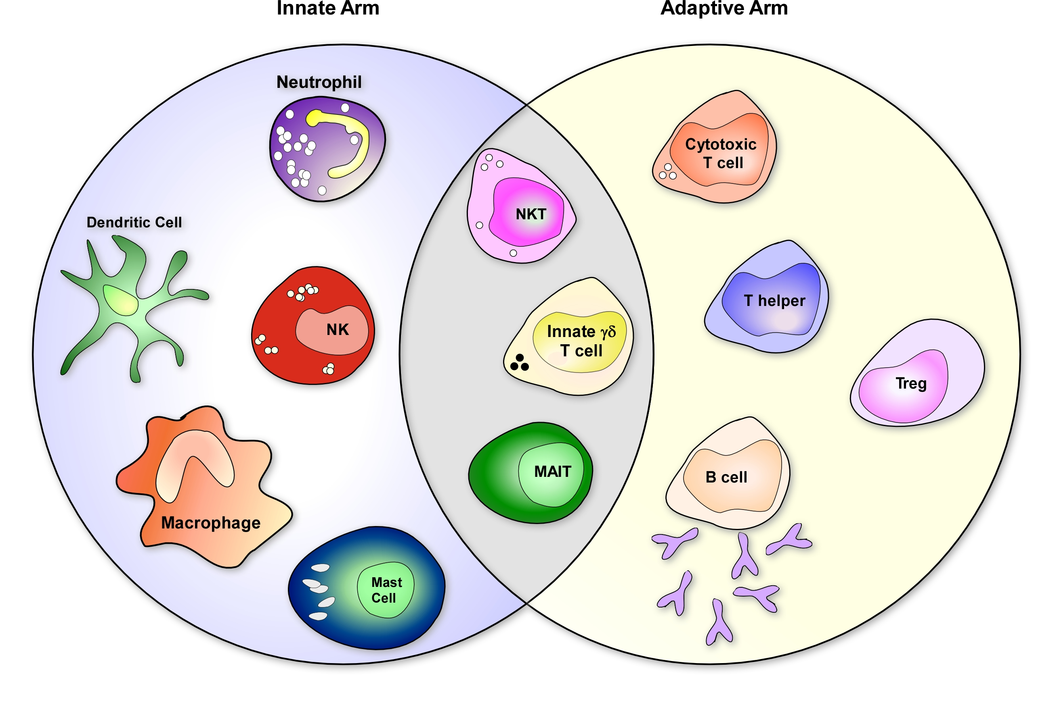
Gamma Delta (γδ) T Cells: Innate-Like T Cells Bridging the Gap Between Innate and Adaptive Immune Systems
Innate Like
Conventional αβ T cells express αβ T cell receptors (TCR), while γδ T cells express γδ TCR.

Slide 2
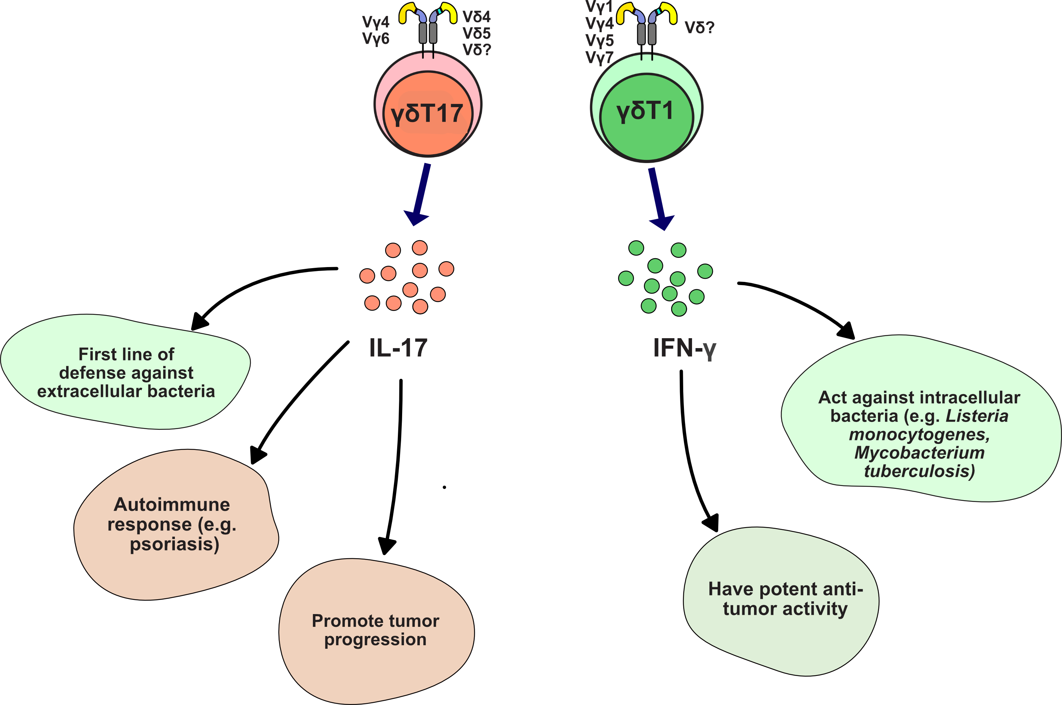
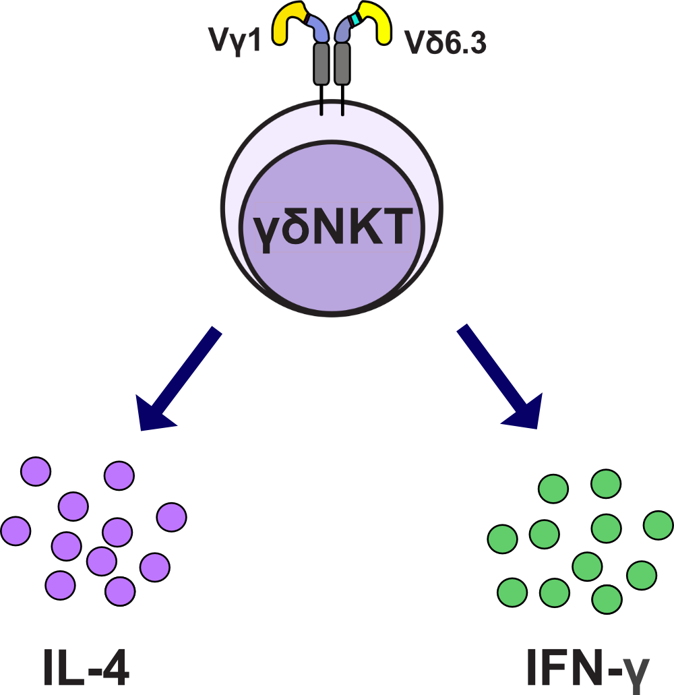
Innate like γδ Τ cells can be subdivided into γδT17, γδT1, and γδT2 functional subsets
γδΤ2
γδΤ1
The signaling mechanism(s) that drives the functional differentiation of γδ T cells is unclear

Slide 3
Innate like γδ Τ cells can be subdivided into γδT17, γδT1, and γδT2 functional subsets
γδΤ2
γδΤ1
The signaling mechanism(s) that drives the functional differentiation of γδ T cells is unclear
One suspected driver of this functional differentiation is the T cell receptor itself

Slide 4
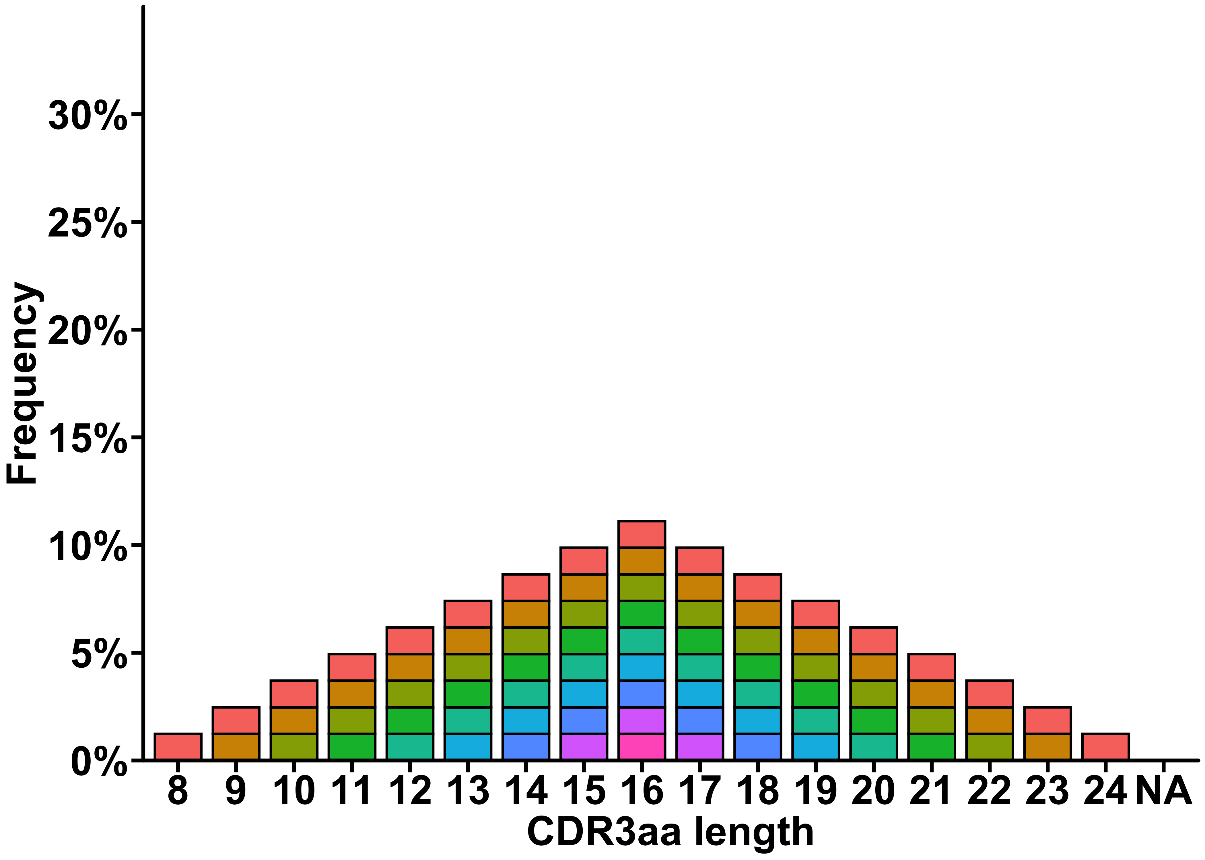
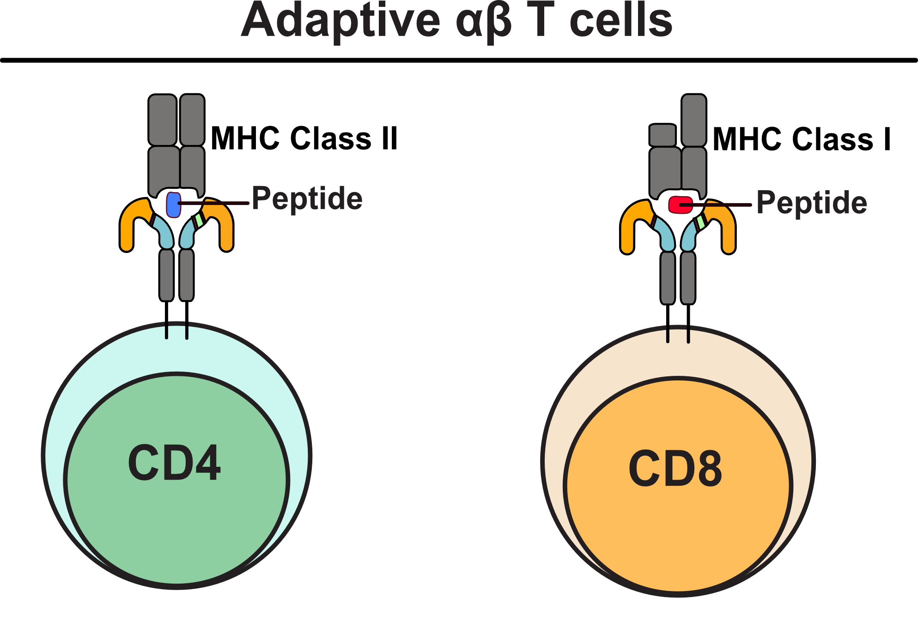
Adaptive αβ T cells Show Highly Diverse TCR Repertoire
Diverse CDR3 Sequences
Diverse CDR3 Spectratype where each bar represents a unique CDR3 sequence
CDR3
V
V
J
J
D
C
C

Slide 5
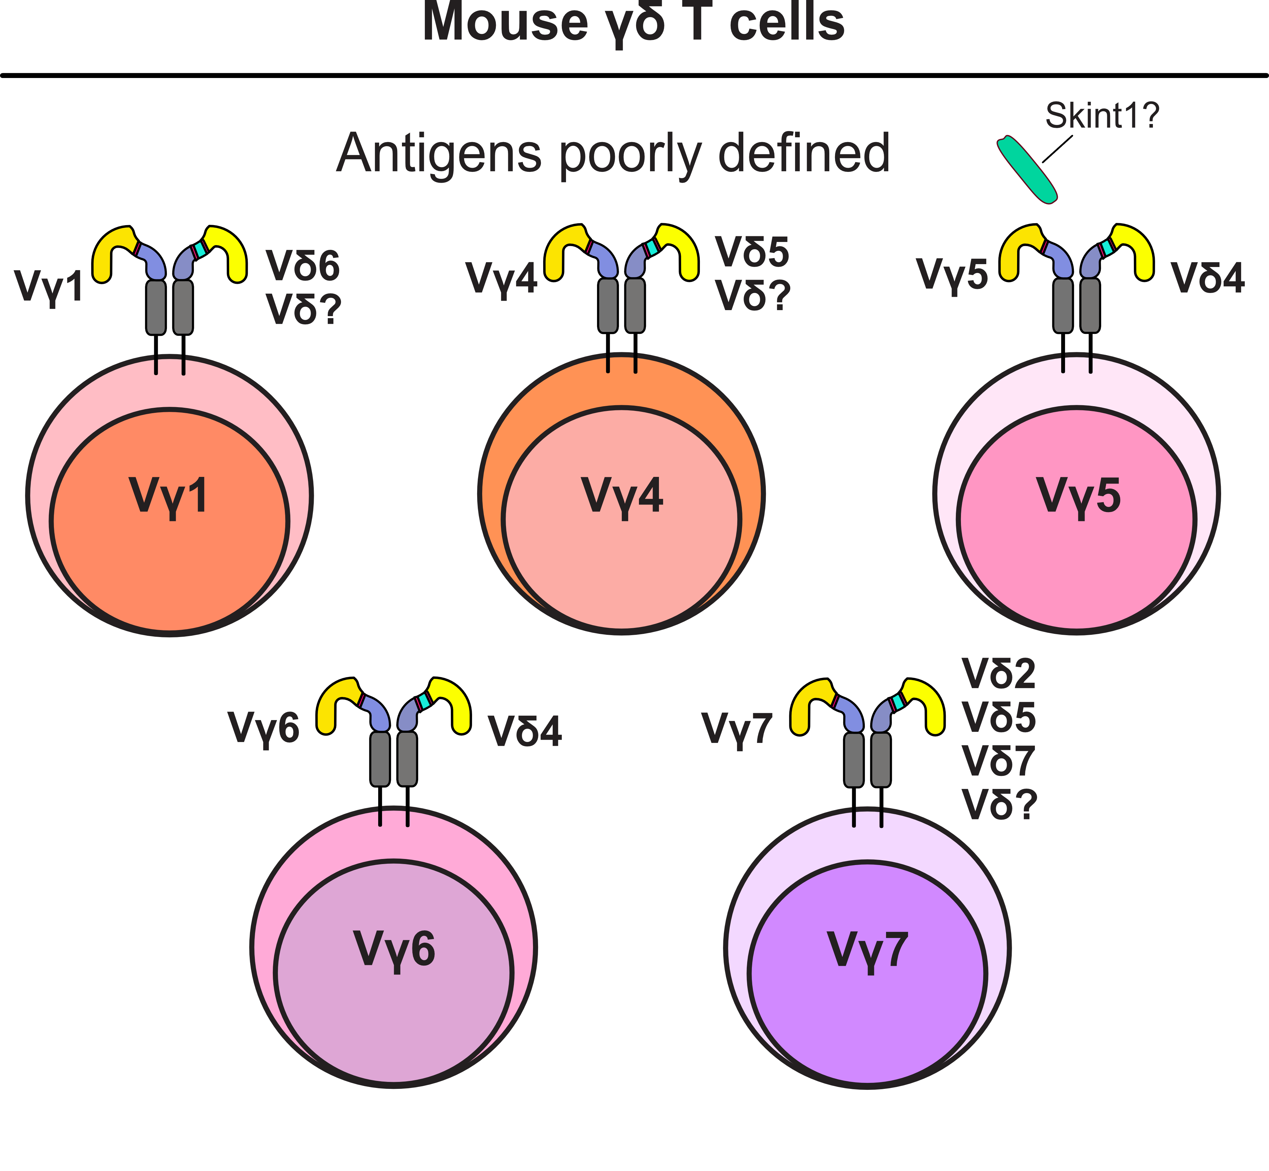
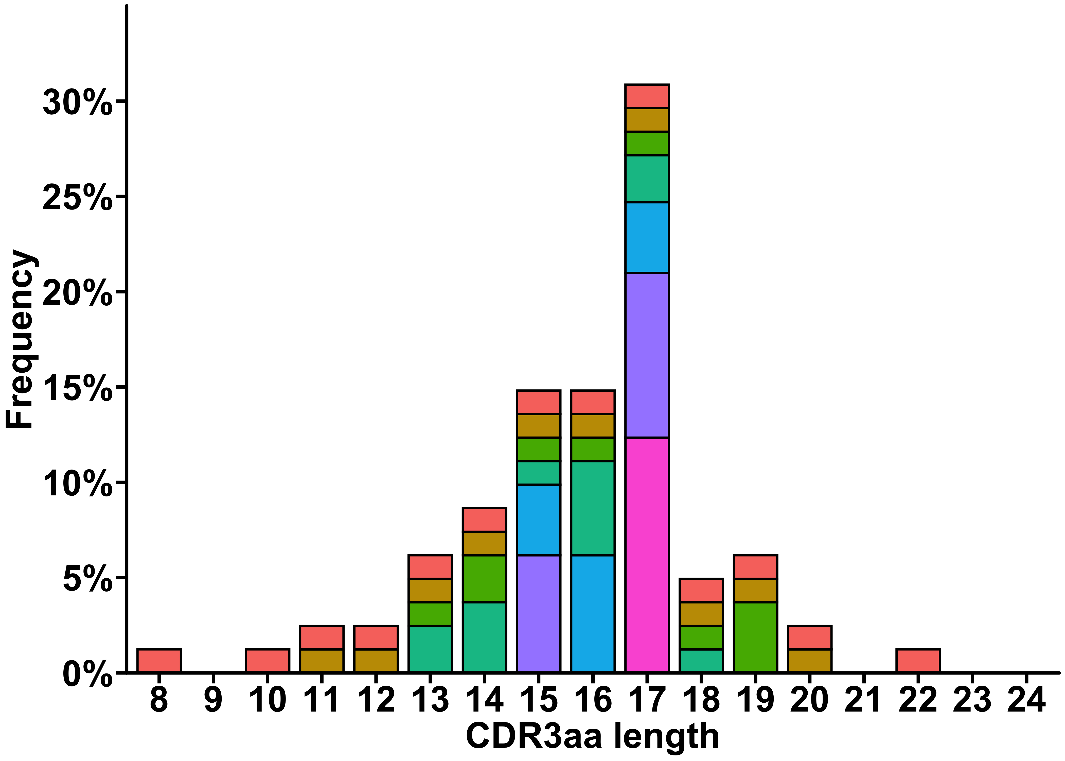
Innate-like Properties of γδ Τ cells Are Linked With Limited Diversity TCR Repertoire
Restricted Diversity CDR3 Spectratype Shows Dominance of a Few CDR3 Clonotypes
High or Low Diversity TCR
Innate-like
Adaptive-like?
& Innate-like
Limited Diversity TCR
Innate-like
Innate-like
Limited Diversity TCR
Notes:
Unlike innate like αβ T cell development,we know very little about the machanisms or pathways that confer an innate-like phenotype on developing γδ Τ cells.

Slide 6
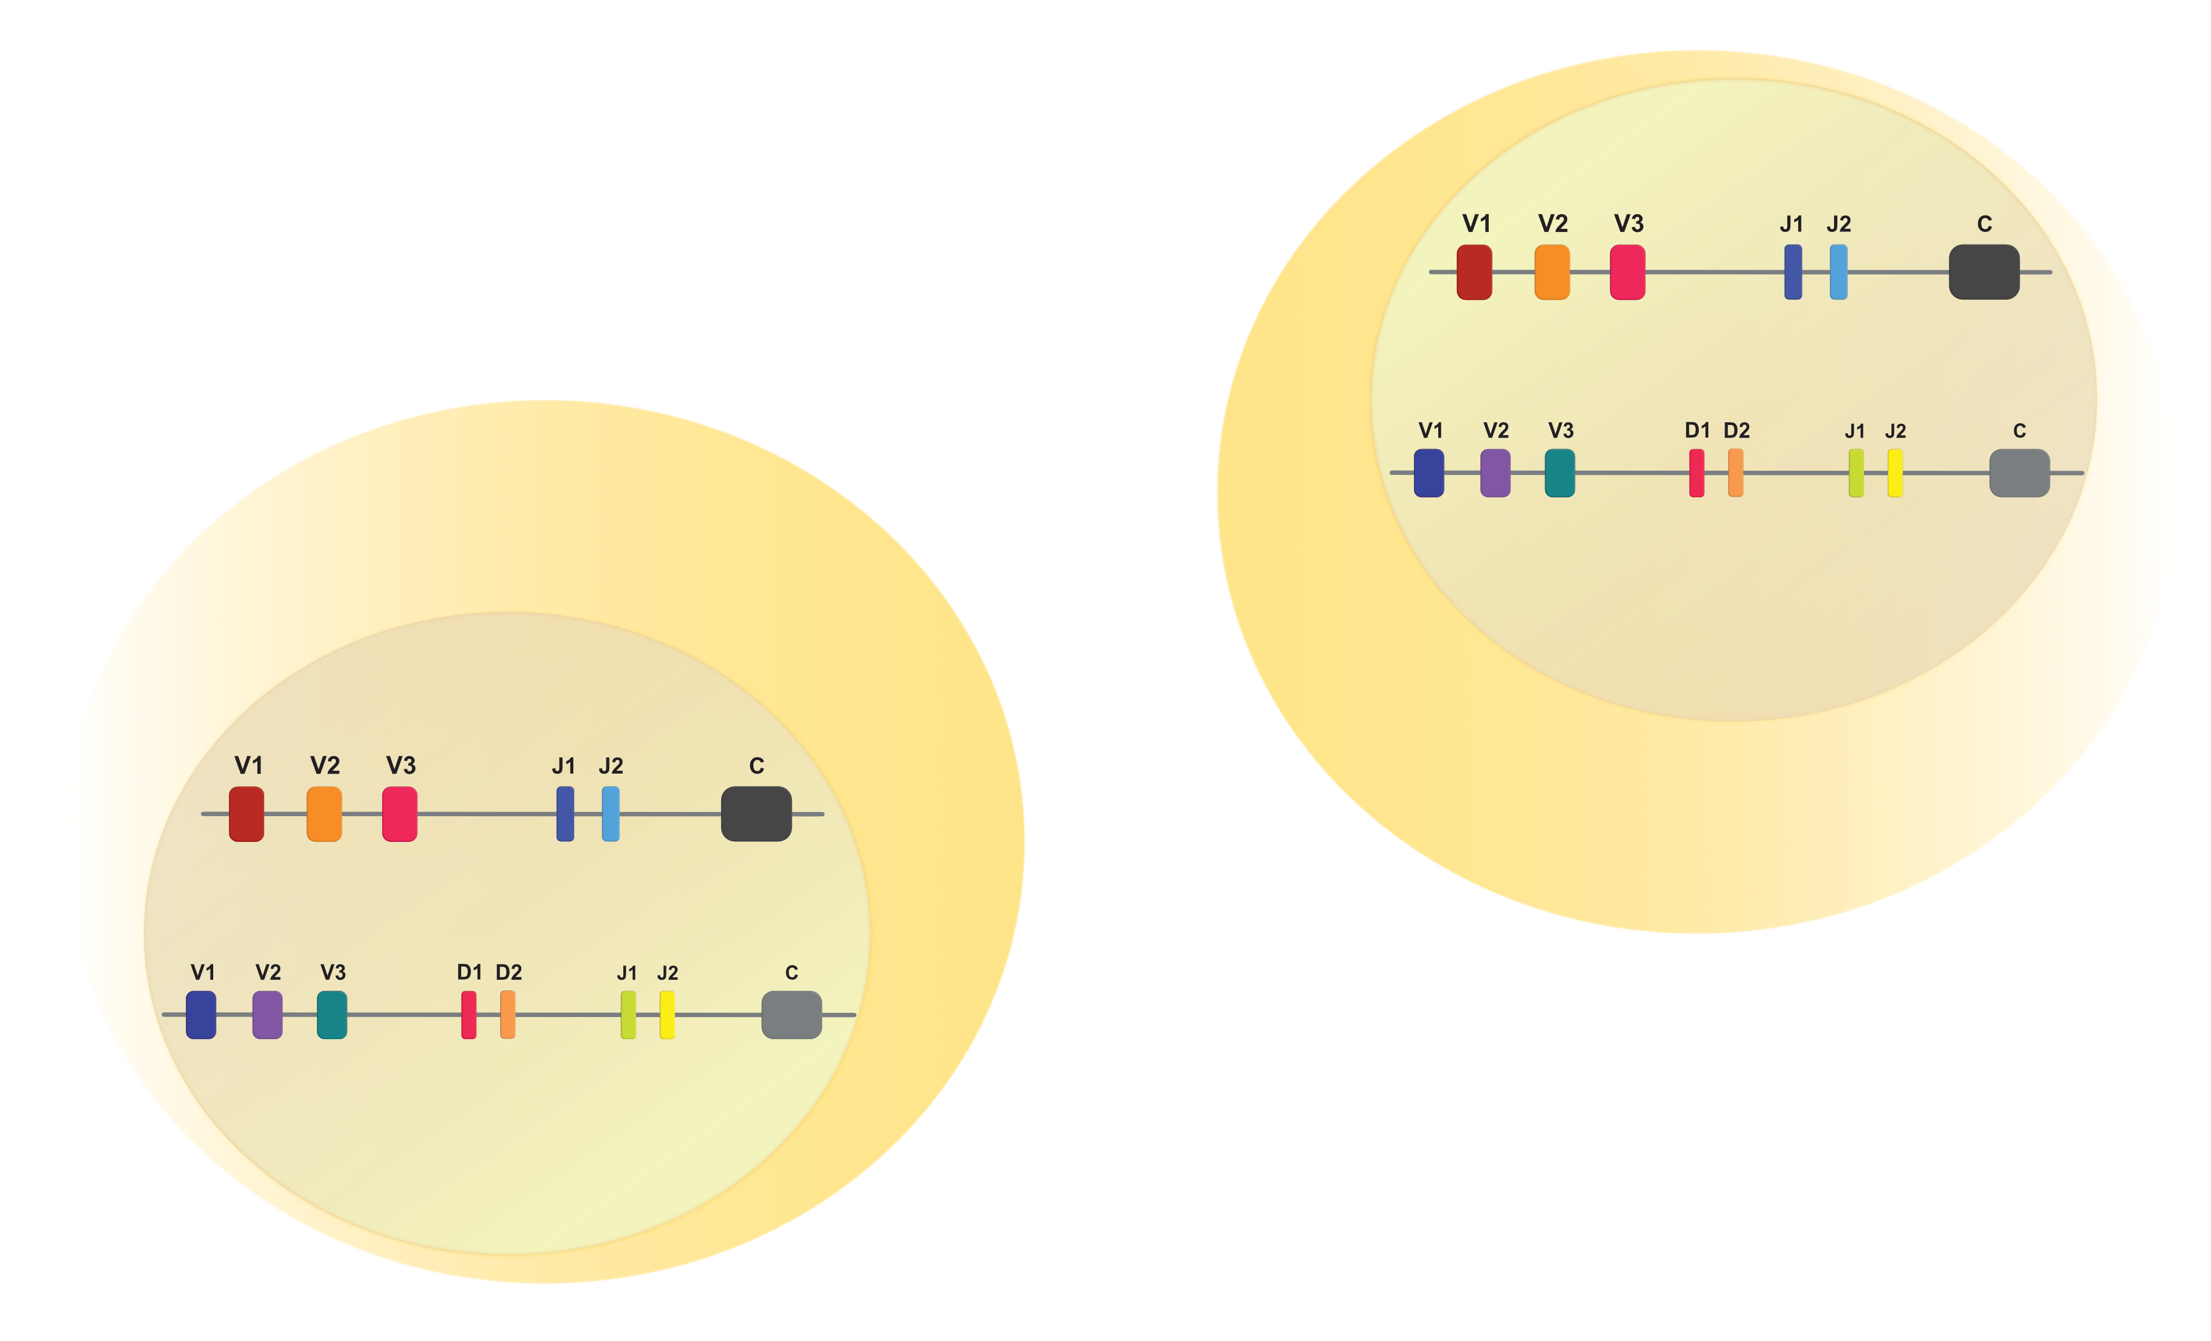
Mechanism of TCR repertoire generation V(D)J Recombination
Notes:
Image from Creative Biolabs, Accessed 13 June, 2018
<https://www.creative-biolabs.com/magic-tcr-repertoire-sequencing-service.html>

Slide 7
Mechanism of TCR repertoire generation Junctional Diversity
TRGV
TRDV
TRGC
TRDC
CDR3 Sequences
TCR CDR3aa clonotype refers to the unique combination of complementarity-determining region 3 sequences from both TCR alpha and beta or TCR gamma and delta chains that form the antigen-binding site and distinguish individual T cell clones.

Slide 8
Rationale
There is a link between innate-like T cells and restricted diversity TCR repertoire.
Innate-like
γδ Τ cells
TCR Repertoire
Notes:
Finally SLAM/SAP signaling pathway has been shown to be crutial for the develoment od specific innate-like cells with charactistic limited diversity TCR repertoire.

Slide 9
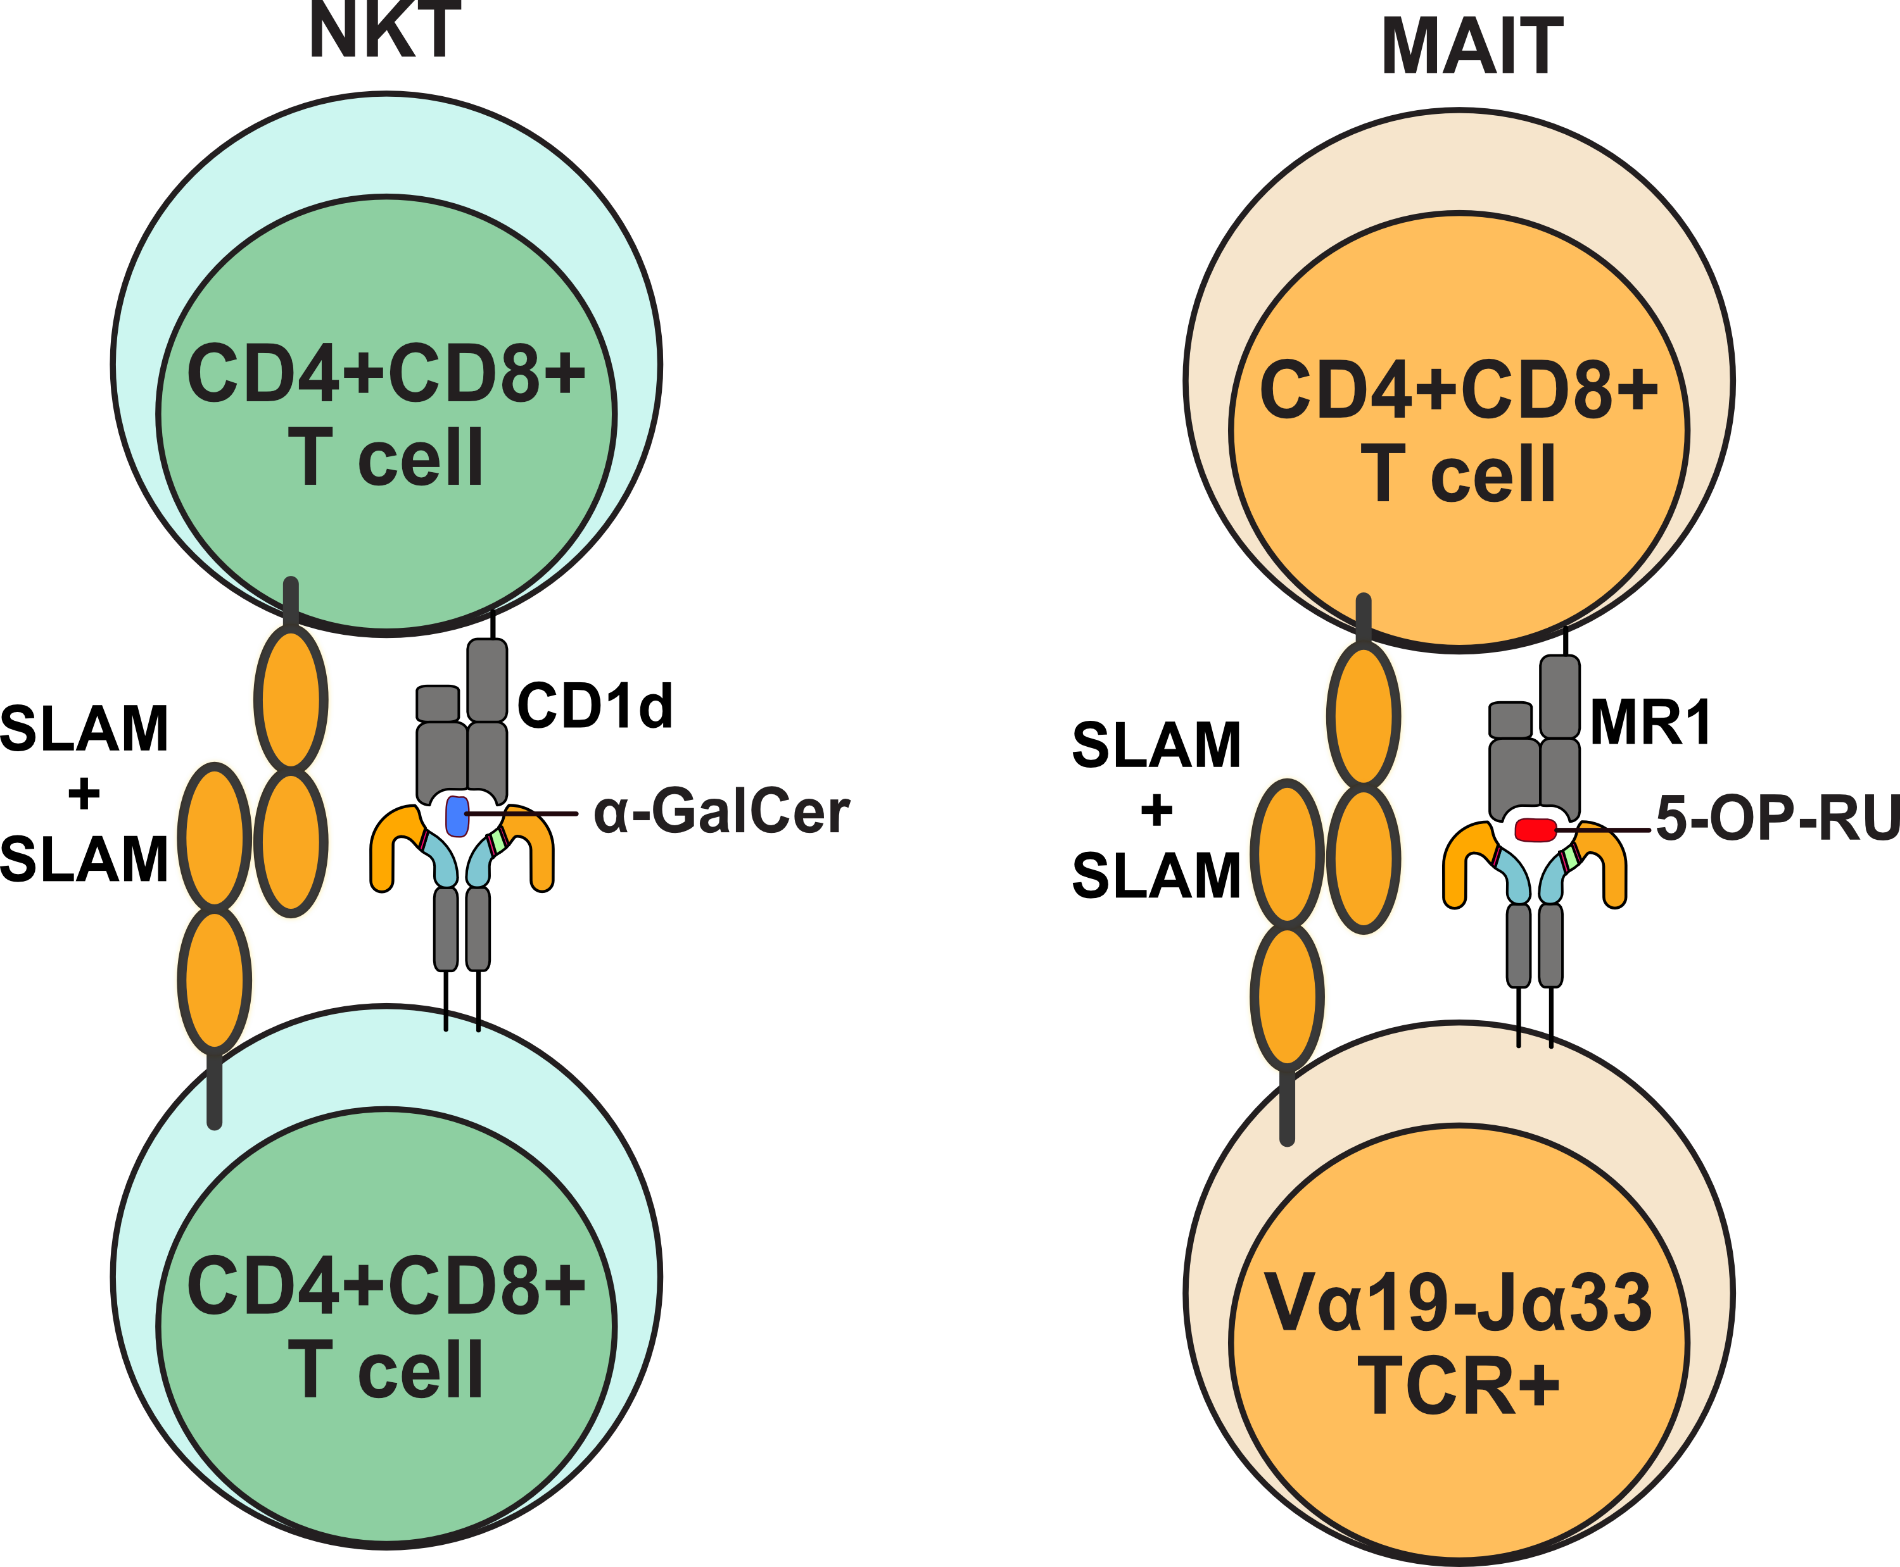
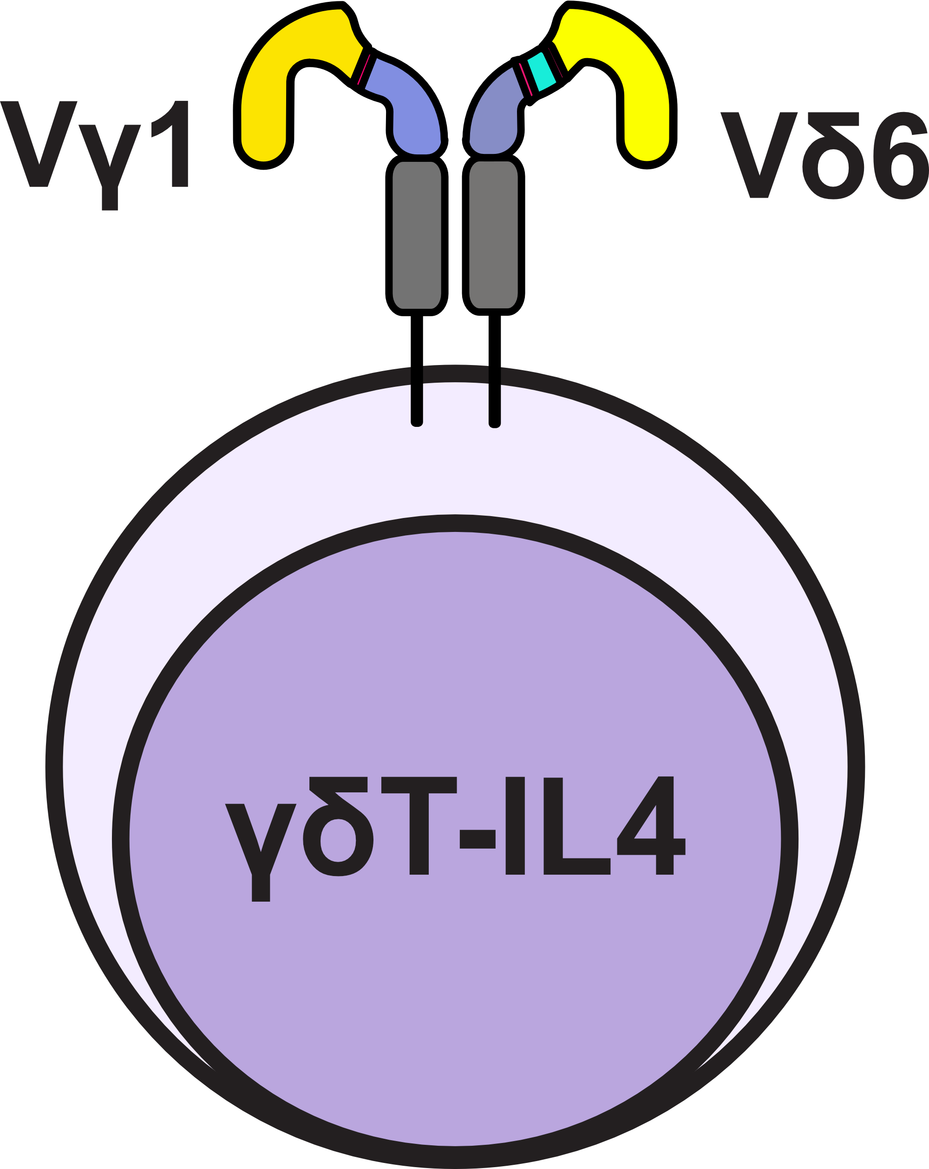
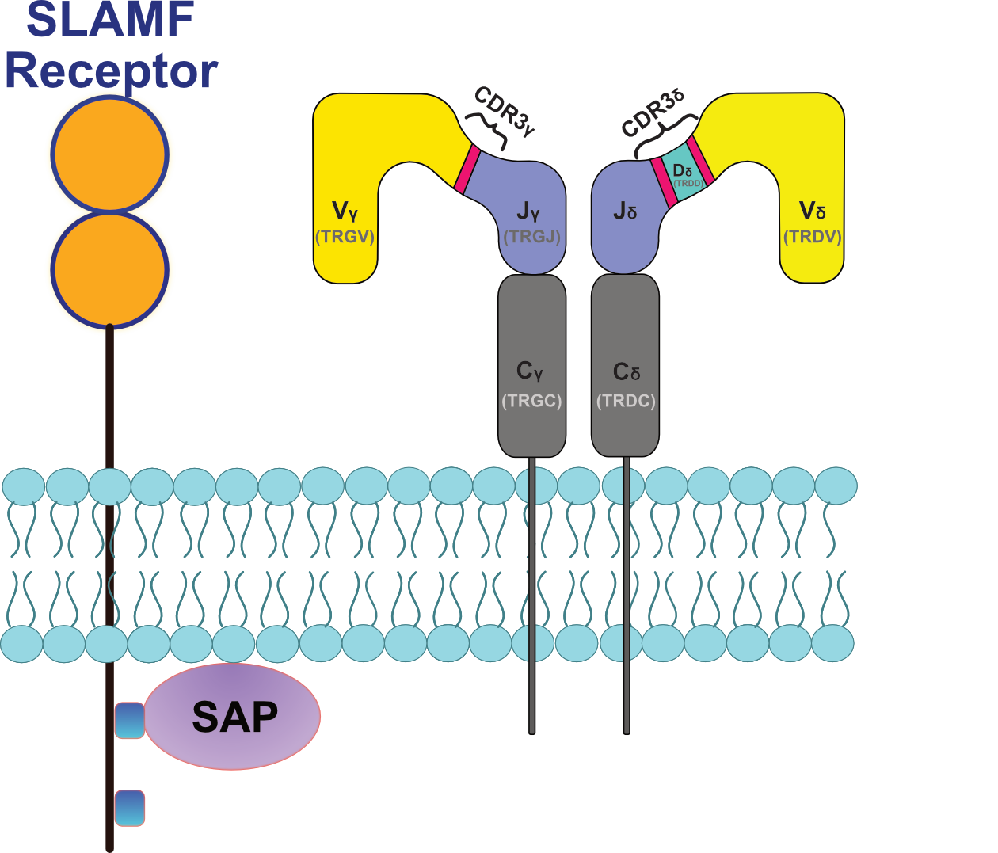
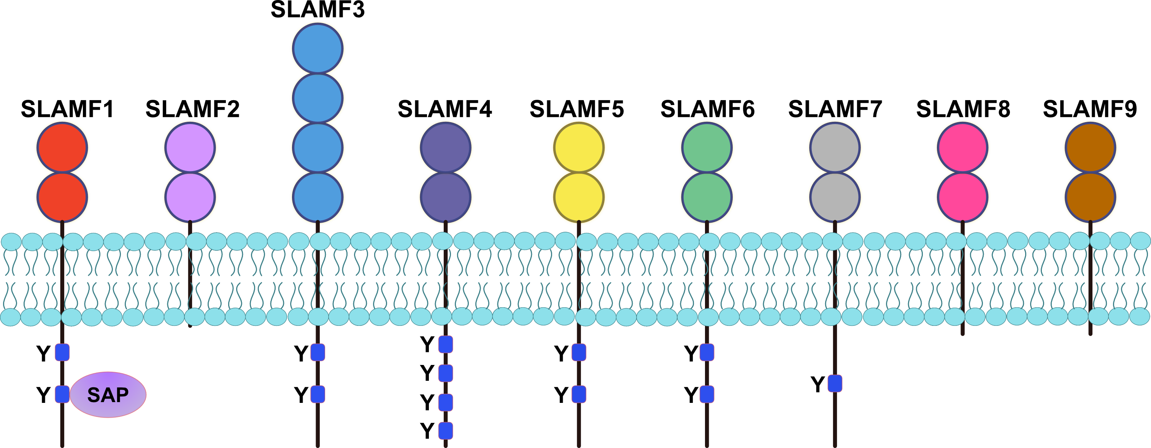
Another signaling mechanism that plays important roles in the development of innate-like T cells is the SLAM/SAP signaling pathway
Majority of Slam family receptors act together with their intracellular signaling counterpart, the Slam-associated protein (SAP)
SLAM/SAP signaling pathway represents a critical checkpoint in the developmental programming of iNKT cells, MAIT cells and γδ ΝΚΤ cells
X

Slide 10
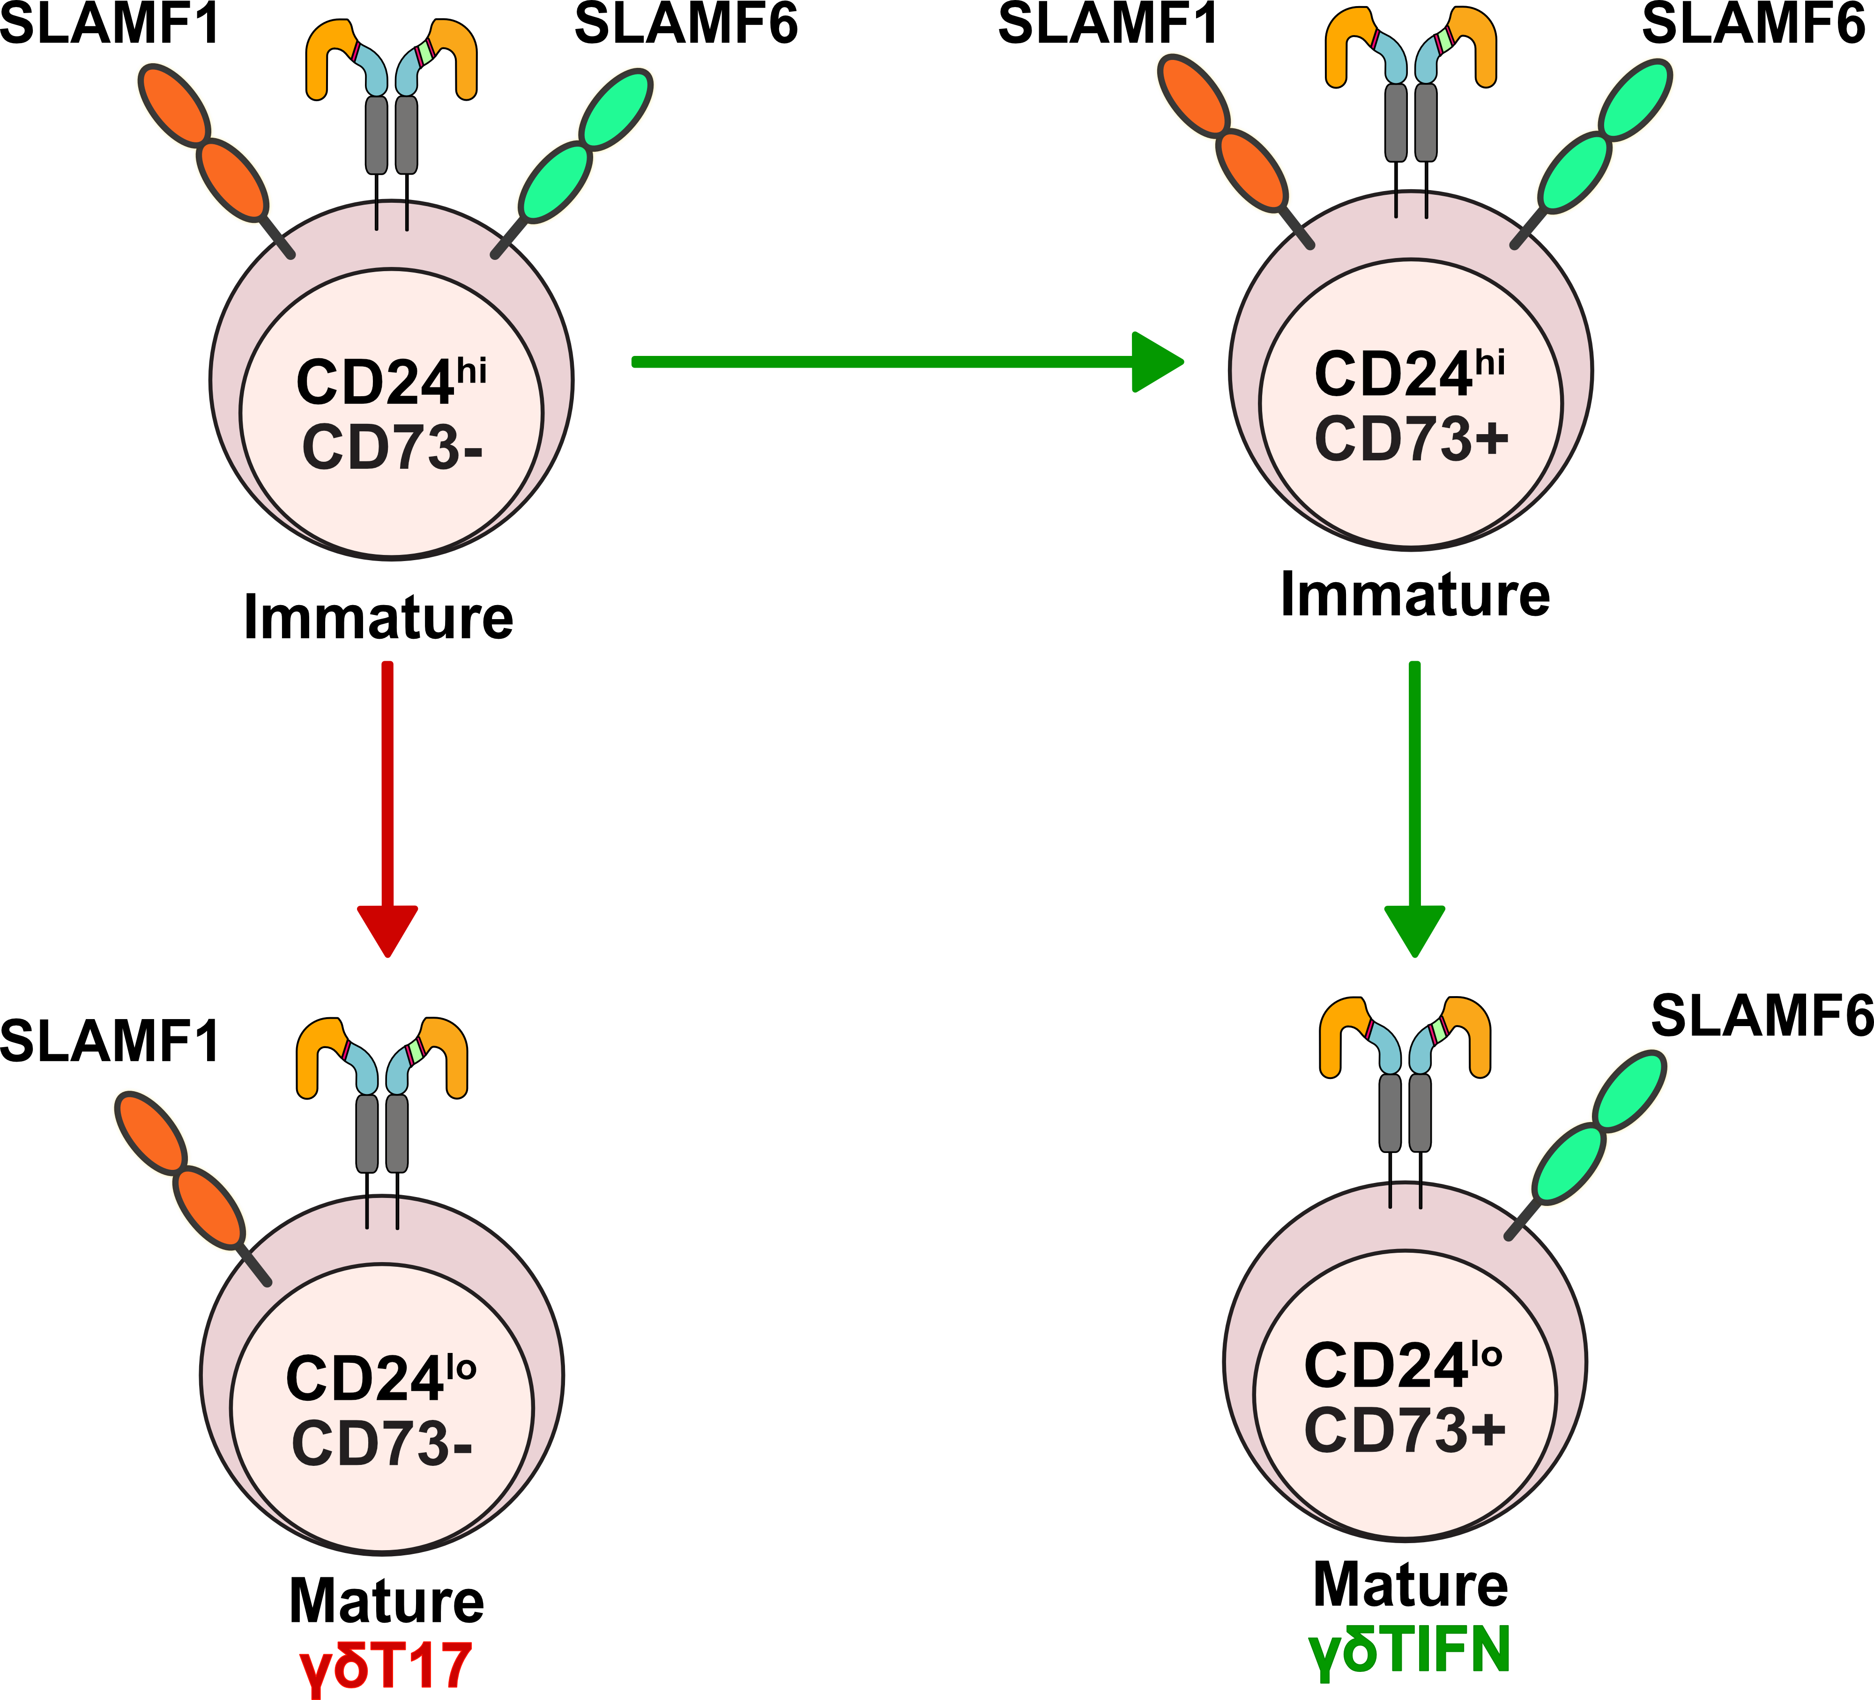
Distinct SLAM receptors mark specific γδ T cell functional subsets and SLAM/SAP signaling pathway is important for the thymic development of ifn-γ- and il-17-producing γδ T cells
X
Mature
γδΤ17
Mature
γδΤ1
Dienz et. al., J. Immunol. (2020)
Notes:
From our lab, we published last year that, SLAM/SAP signaling pathway regulates the thymic development of IFNg and IL17 producing γδ Τ cells. Also, we have shown that as the γδ Τ cells progress from immature to mature state identified by CD24 and CD73 expression, the γδ Τ cells move from a SF1 and SF6 DP state to SF1 or SF6 SP state.

Slide 11
Rationale
There is a link between innate-like T cells and restricted diversity TCR repertoire.
We have previously shown that the SLAM/SAP signaling pathway is important for the development of IFN-γ- and IL-17-producing γδ T cells.
Innate-like
γδ Τ cells
SLAM/SAP
Signaling
TCR Repertoire

Slide 12
Rationale
There is a link between innate-like T cells and restricted diversity TCR repertoire.
We have previously shown that the SLAM/SAP signaling pathway is important for the development of IFN-γ- and IL-17-producing γδ T cells.
Innate-like
γδ Τ cells
SLAM/SAP
Signaling
TCR Repertoire
Questions
1. Is there an association between distinct co-expression profiles of the SLAM family receptors and T cell receptor (TCR) repertoire diversity of innate-like γδ T cell subsets?
2. Does the SLAM/SAP signaling pathway regulate the development of specific innate-like γδ TCR clonotypes with distinct effector functions?
Notes:
Finally SLAM/SAP signaling pathway has been shown to be crutial for the develoment od specific innate-like cells with charactistic limited diversity TCR repertoire.

Slide 13
Rationale
There is a link between innate-like T cells and restricted diversity TCR repertoire.
We have previously shown that the SLAM/SAP signaling pathway is important for the development of IFN-γ- and IL-17-producing γδ T cells.
Innate-like
γδ Τ cells
SLAM/SAP
Signaling
TCR Repertoire
Questions
1. Is there an association between distinct co-expression profiles of the SLAM family receptors and T cell receptor (TCR) repertoire diversity of innate-like γδ T cell subsets?
2. Does the SLAM/SAP signaling pathway regulate the development of specific innate-like γδ TCR clonotypes with distinct effector functions?
To obtain answers to these questions, the most effective way is to utilize a single-cell multi-omics approach that combines scRNAseq, cell surface protein expression, and TCR repertoire profiling.

Slide 14
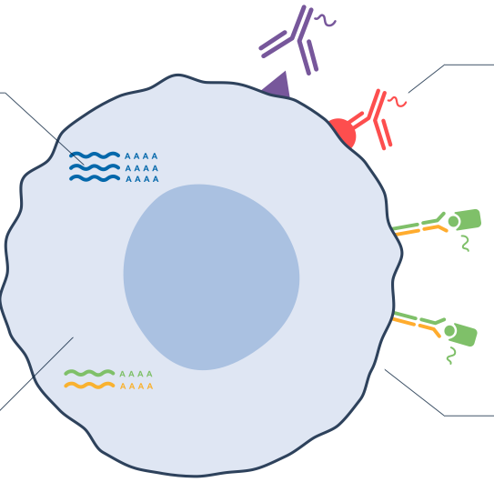
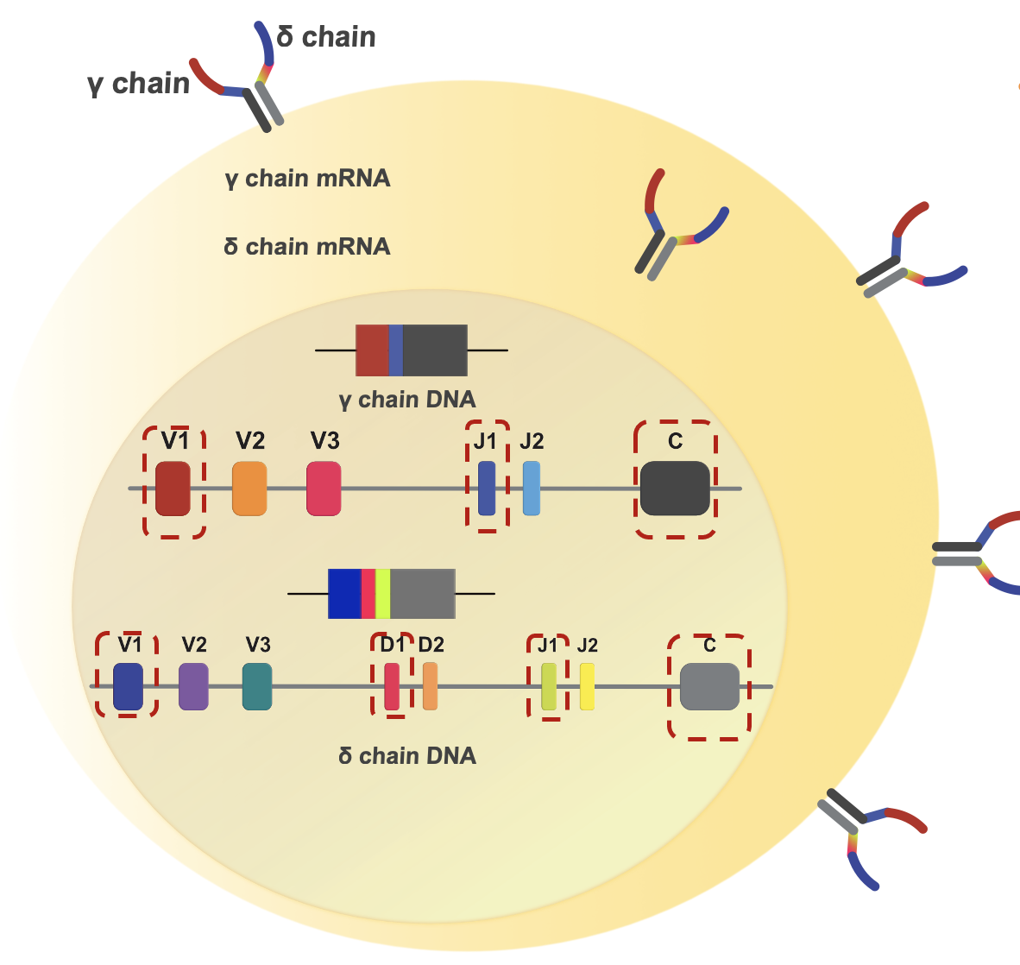
Objective:
Utilize a single-cell multi-omics approach to dissect the regulatory role of SLAM/SAP signaling on the development of specific γδ TCR clonotypes
Gene Expression (GEX)
Cell Surface Protein (CSP) Expression
TCR VDJ

Slide 15
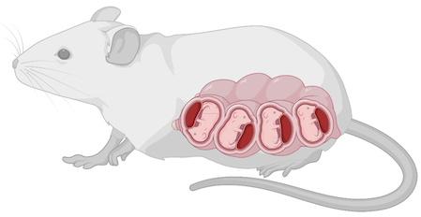



Experimental Design
B6
SAP KO
Thymus-1
Thymus-2
Thymus-3
Thymus-4
Thymus-1
Thymus-2
Thymus-3
Thymus-4
B6-1
B6-2
B6-3
B6-4
SAP-1
SAP-2
SAP-3
SAP-4

Slide 16
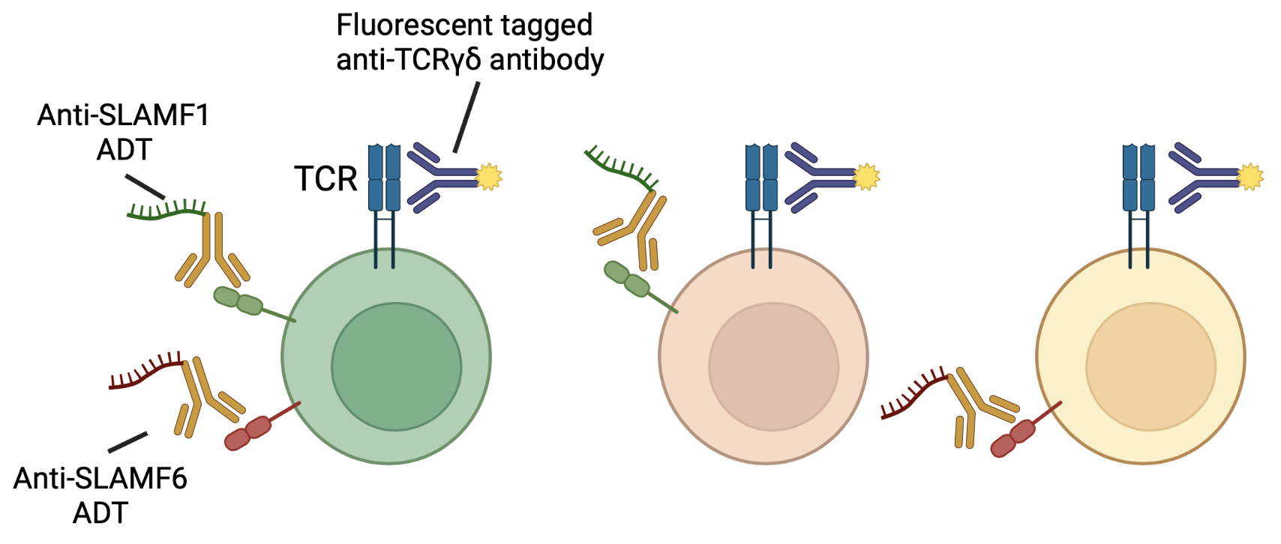
Experimental Design cont….
B6-1
B6-2
B6-3
B6-4
SAP-1
SAP-2
SAP-3
SAP-4
Staining all the cells with fluorescent tagged antibodies for FACS sorting of γδ T cells
+
Staining all the cells with Antibody Derived Tags (ADT), which are a specific type of antibody oligonucleotide conjugates (Totalseq-C, Biolegend) targeting cell surface protein expression of selected markers.

Slide 17


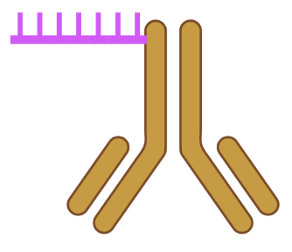
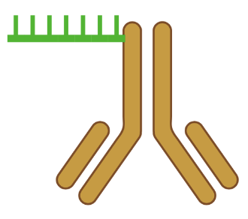




Experimental Design cont….
B6-1
B6-2
B6-3
B6-4
SAP-1
SAP-2
SAP-3
SAP-4
Staining cells from each sample separately with unique Hash Tag Oligonucleotide (HTO), which are a specific type of antibody oligonucleotide conjugates (Totalseq-C, Biolegend) targeting common cell surface markers such as CD45 and MHC class I.
Hashtag-1
Hashtag-2
Hashtag-3
Hashtag-4
Hashtag-5
Hashtag-6
Hashtag-7
Hashtag-8

Slide 18
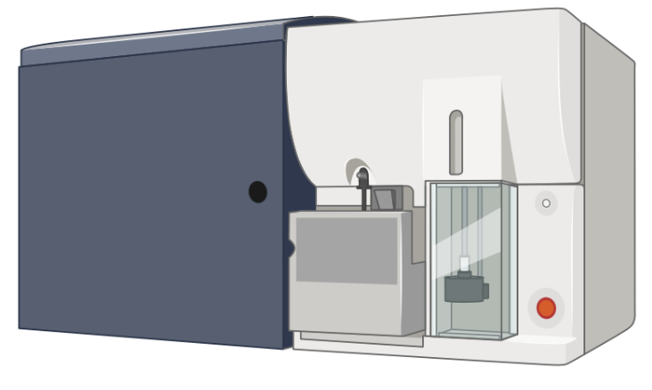
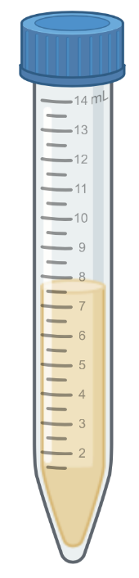
Experimental Design cont….
Hashtag-1
Hashtag-2
Hashtag-3
Hashtag-4
Hashtag-5
Hashtag-6
Hashtag-7
Hashtag-8
FACS of Live CD45⁺ CD11b⁻CD11c⁻CD19⁻TCRβ⁻ γδTCR⁺ cells
(Sort equal number of cells from each of the B6 samples into one B6 collection tube and sort equal number of cells from each of the SAP KO samples into one SAP KO collection tube)
B6
Collection
Tube
SAP KO
Collection
Tube

Slide 19

Experimental Design cont….
B6
Collection
Tube
SAP KO
Collection
Tube
Spin at 400 rcf for 10 mins (4⁰C)
Combine all the cells into one 1.5ml microcentrifuge tube
Resuspend and Count
Adjust concentration (if needed) and proceed to library preparation following 10X genomics kit protocols
As we are interested in single cell immune profiling, we need to use the Chromium Next GEM Single Cell 5' Reagent Kits (v1.1 or v2)

Slide 20
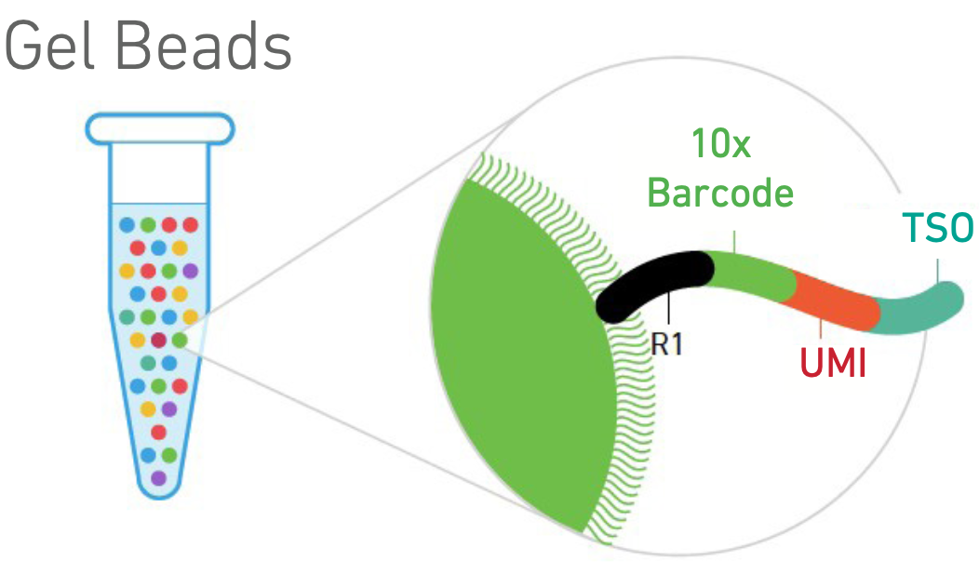
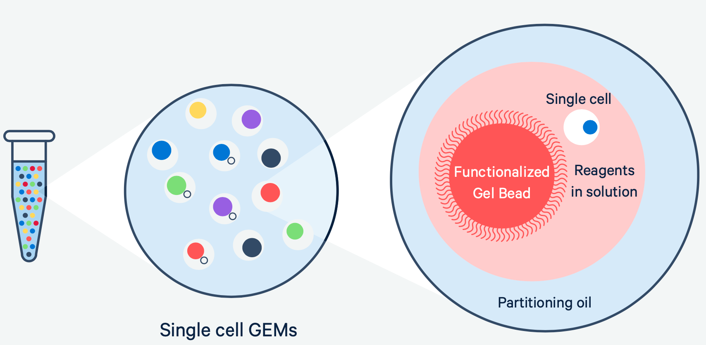

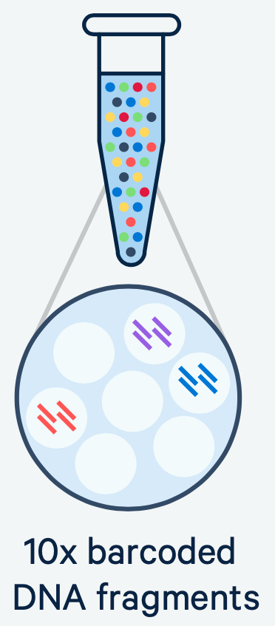
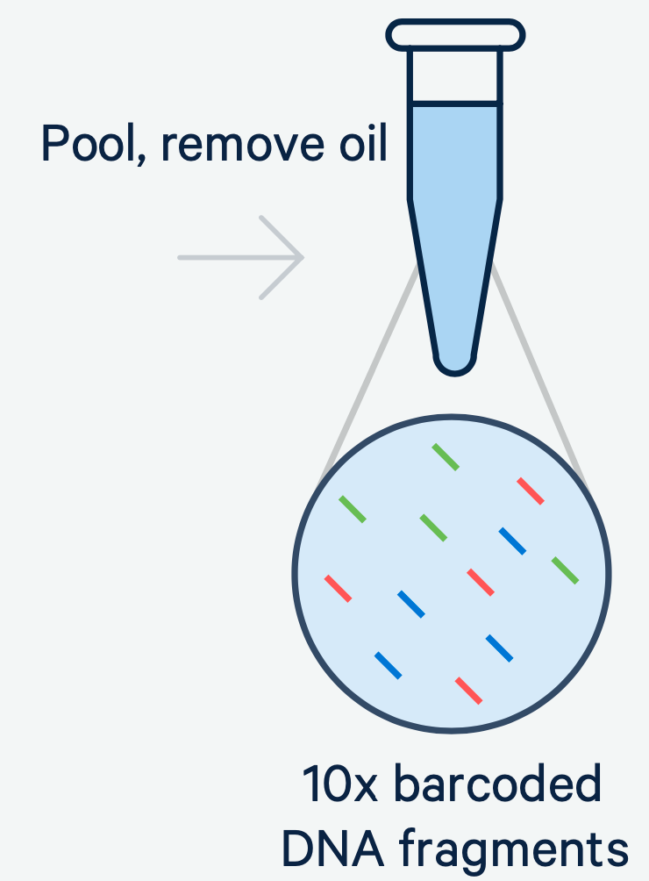
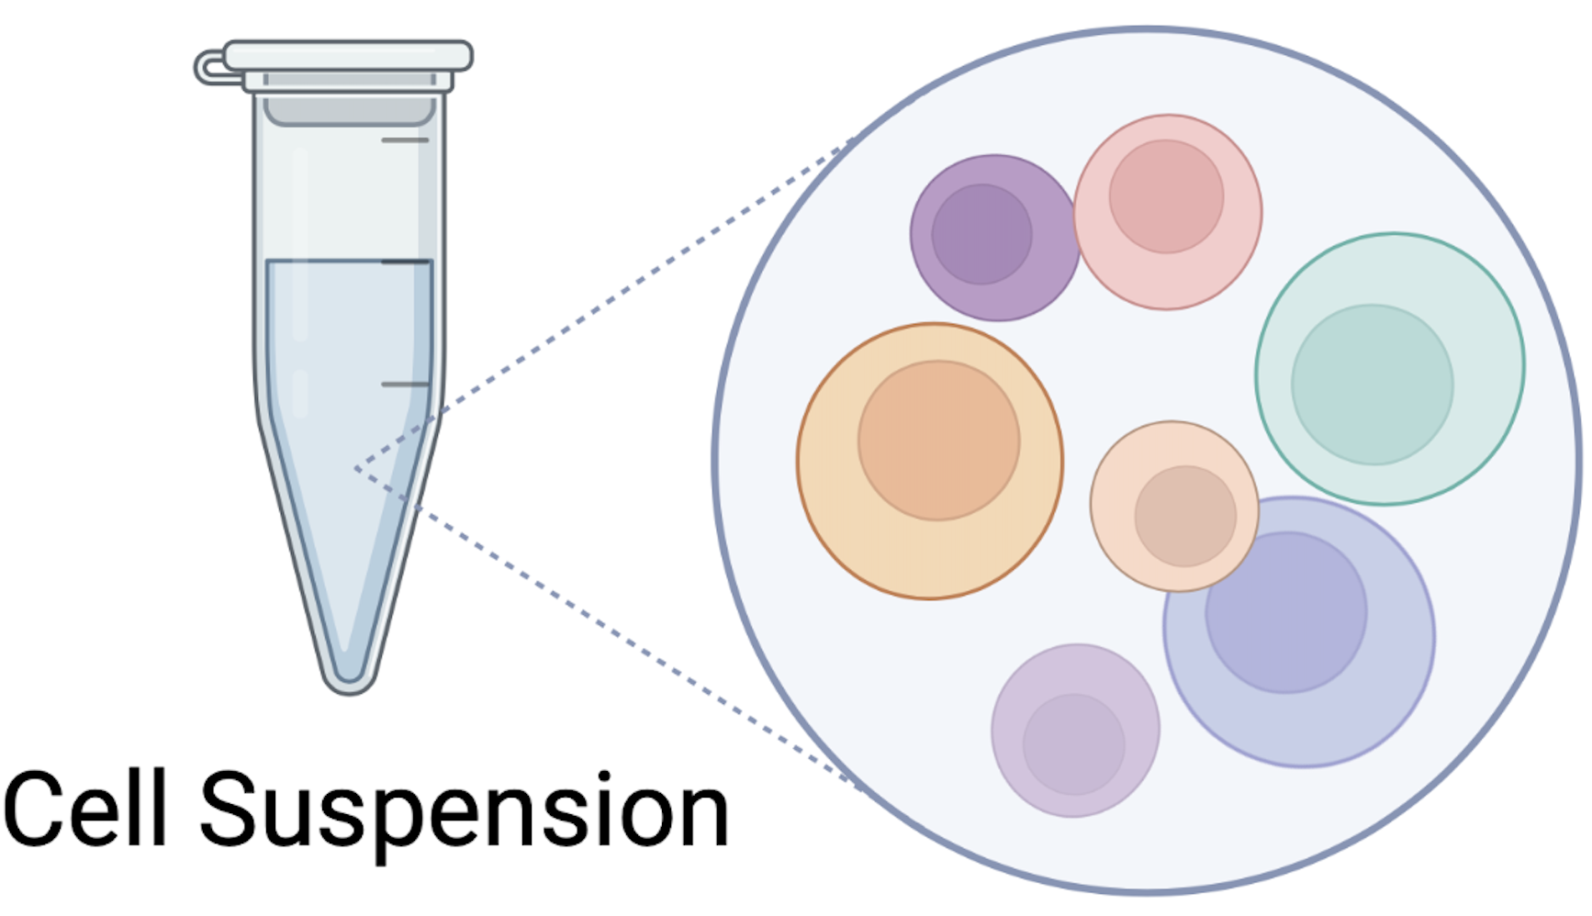
How it works: From cells to sequencing-ready libraries

Slide 21
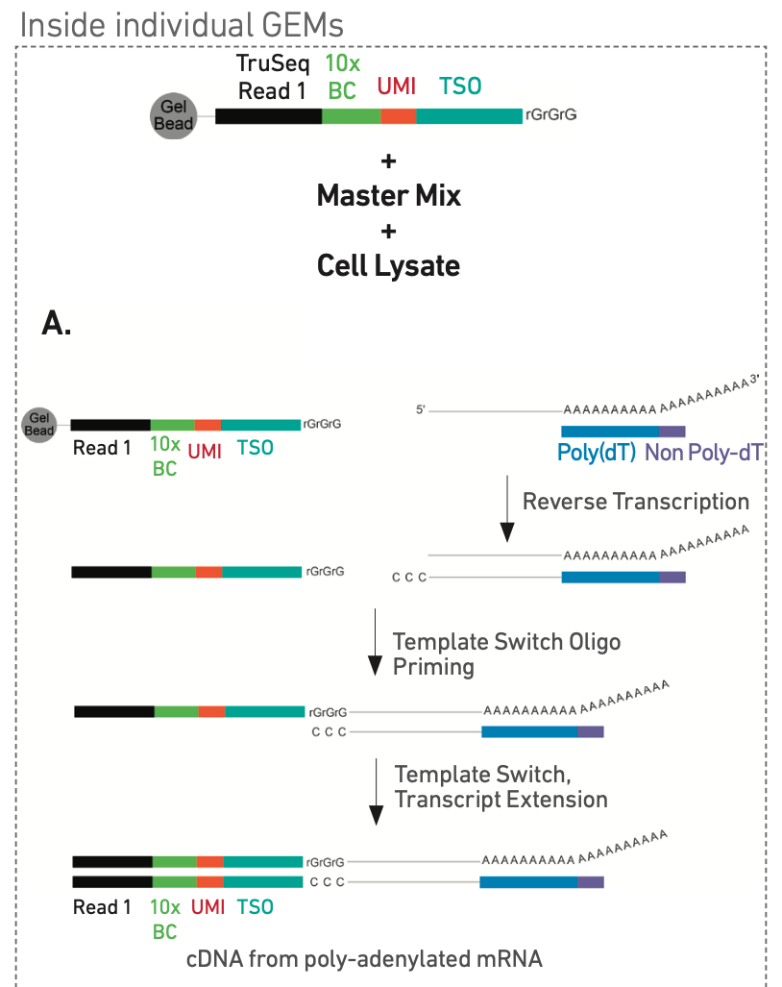
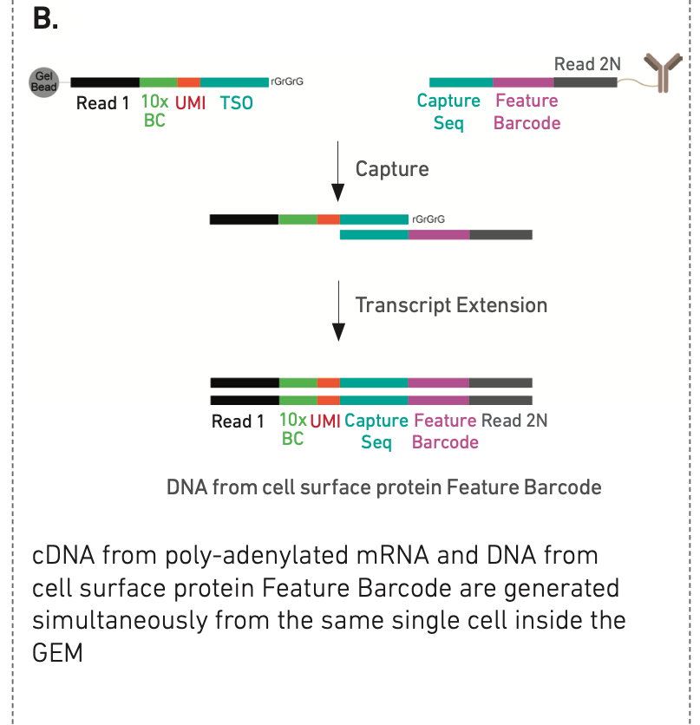
Step 1: GEM Generation and Barcoding
CSP
GEX

Slide 22
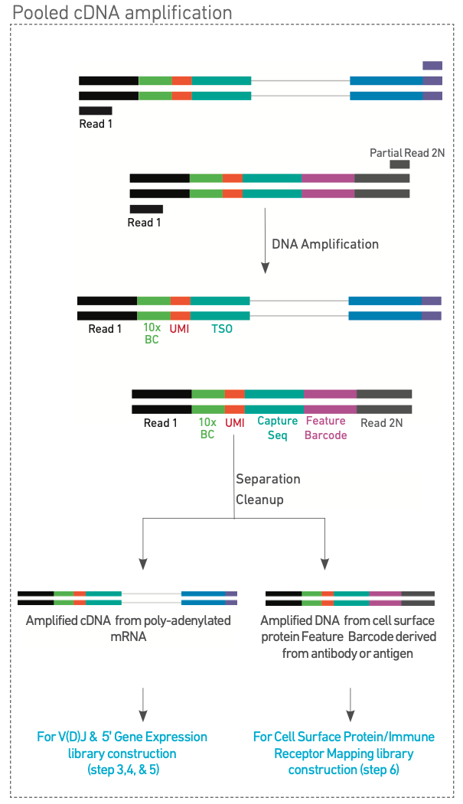
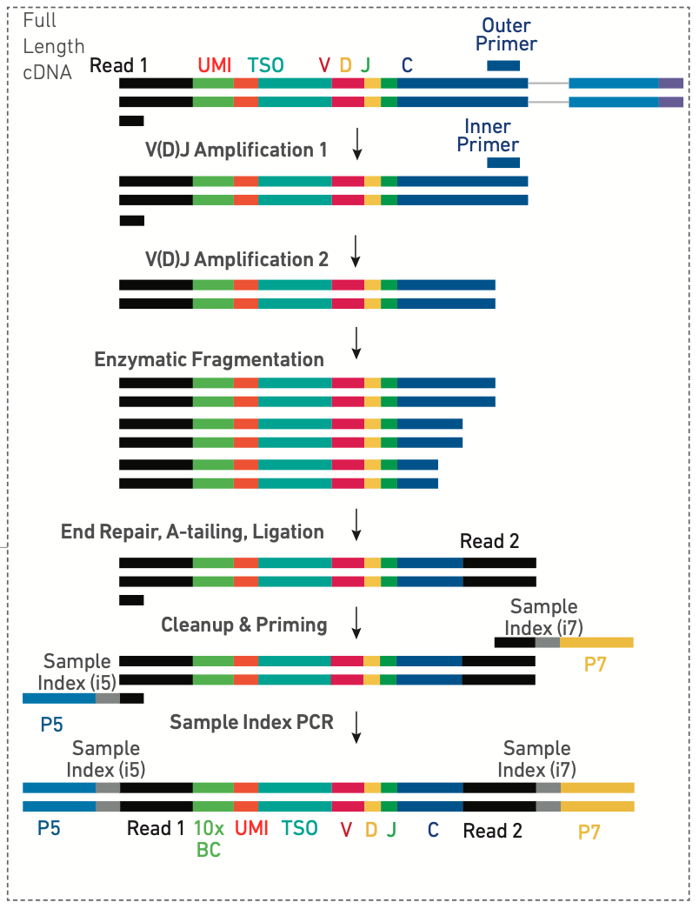
Step 2:Pooled cDNA amplification
Step 3: VDJ enrichment and Library Construction

Slide 23
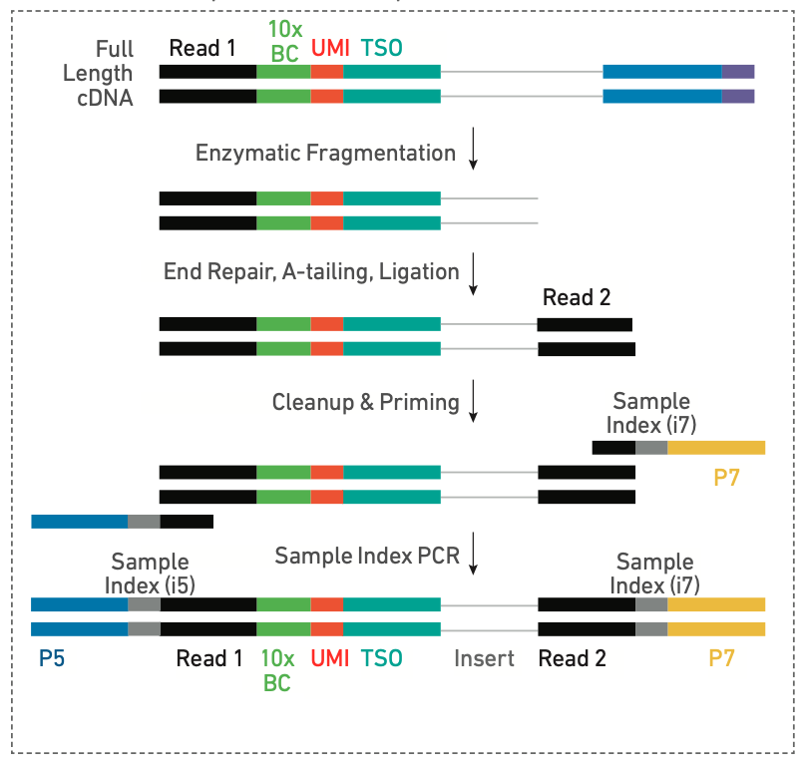
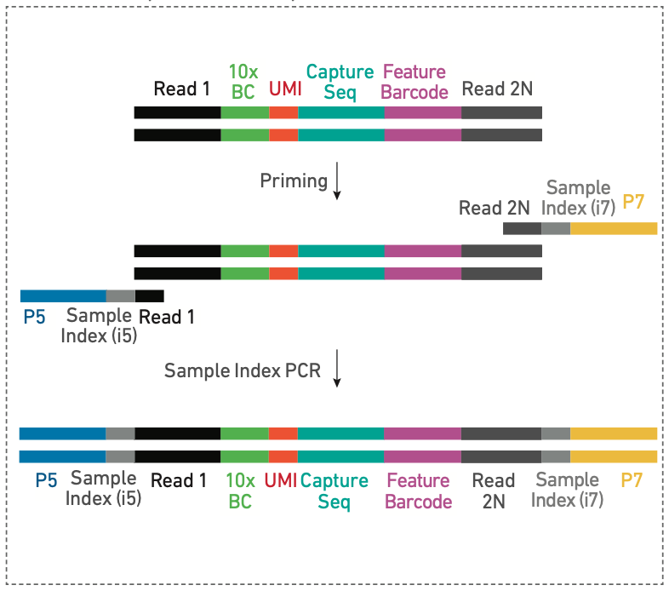
Step 4: 5ʹ Gene Expression (GEX) Library Construction
Step 5: 5ʹ Cell Surface Protein (CSP) Library Construction

Slide 24
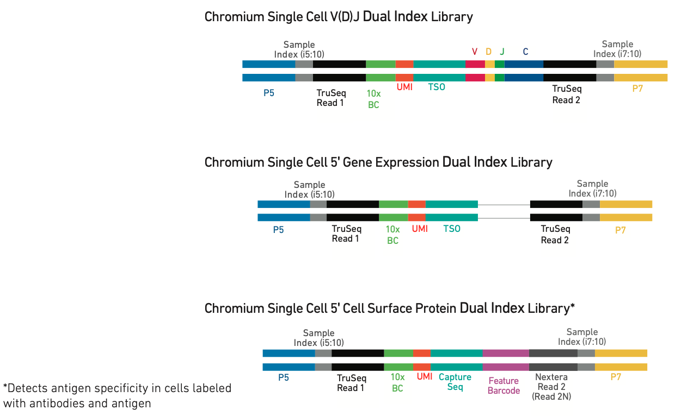
Step 6: Sequencing

